Slide 1
Airbnb Data Analysis By Gouri Phadtare

Slide 2
Agenda
Objective
Background
Key Findings
Appendix:
- Data Methodology
- Assumptions

Slide 3
Objective
Improve strategies to review the business in the post covid period.
Understand customer preferences and user experience trends for Airbnb NYC business.
Provide early recommendations for new acquisitions and improving customer experience.

Slide 4
Background
The COVID-19 pandemic affected Airbnb business due to travel restrictions.
The revenue took the largest hit in NYC in the Q2 of 2020.
Now that the travel restrictions are lifted, the business should be operated to recover the loss.

Slide 5
Key findings

Slide 6
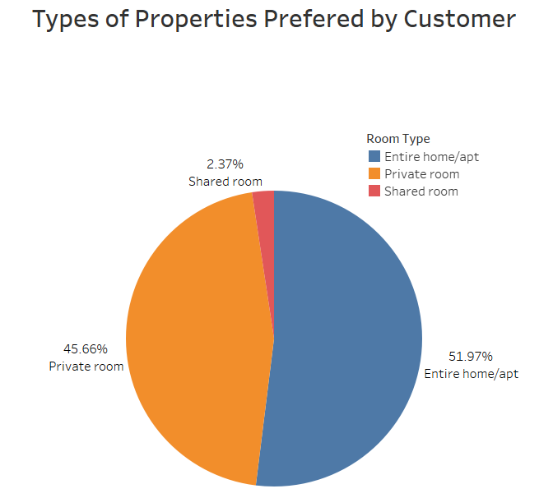
1.Customer Preferences for Entire Apt / Pvt. Room should remain high post covid
Customer prefers Entire home or private rooms most
Entire home/apt contributes 51.9% followed by Private room with 45.66%
Shared room accounts only 2.37%

Slide 7
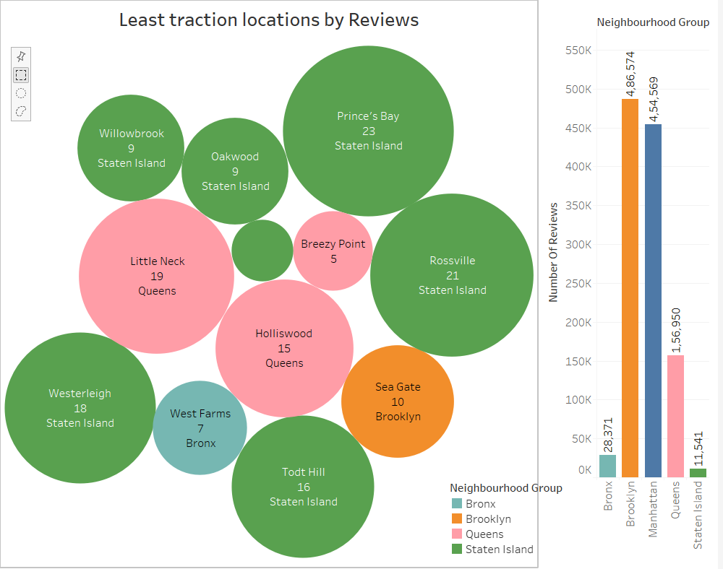
2.Properties in Bay Terrace neighbourhood from Staten Island group should make more customer oriented
Staten Island properties receives less reviews 11,544. Followed by Bronxs and Queens with reviews 28,871 and 1,56,950 respectively.
Properties from Bay terrace, Oakwood, Willowbrook in Staten Island should make more customer oriented.
West Farms from Bronxs and Little Neck, Breezy point and Holiswood from Queens properties should be followed next.

Slide 8
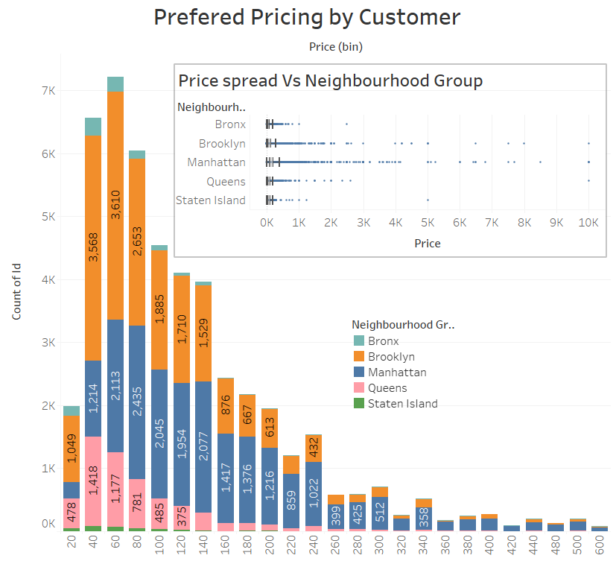
3.Acquiring Premium Properties in Bronxs and Non-Premium Properties in Manhattan
Premium properties in Bronxs should be targeted as cost is already low. Non Premium properties in Manhattan should be targeted as rates are high.
Can be switch to 60-200 Pricing bucket as they are mostly preferred by customers.
Properties in Manhattan are most expensive with maximum pricing offered while Bronxs are least expensive.

Slide 9
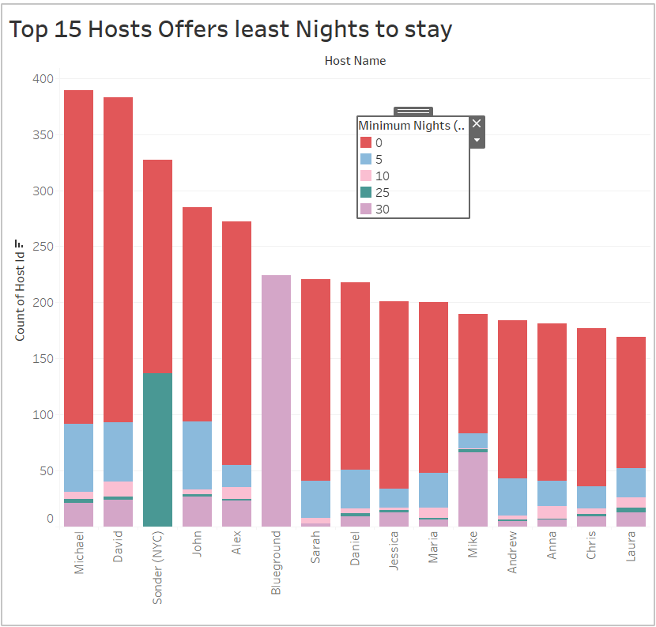
4.Top 15 hosts offers least nights to stay
For minimum nights to stay from 0-5 nights, has maximum listing beyond 35K in past.
Michael is topmost listed host followed by David with we can have one on one conversation to grow.
Sonder(NYC) and Blue ground hosts are also offers 20-25 and 25-30 days stay.

Slide 10
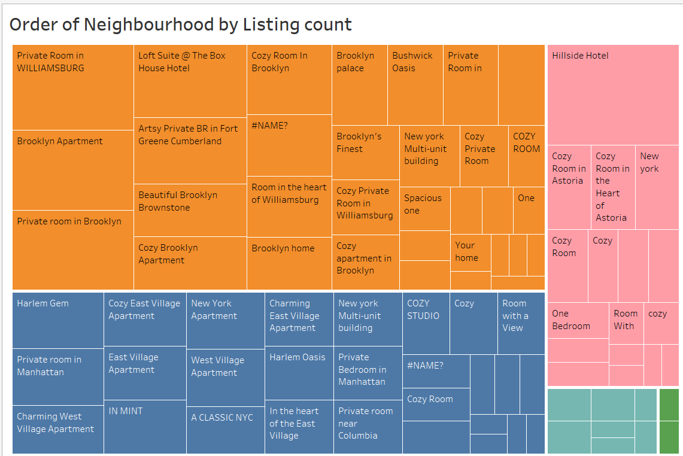
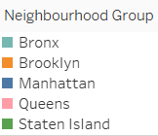
5.Optimise order of property Listing
Hillside hotel listed most of times from Queens neighbourhood group.
Private rooms in Williamsburg has maximum listing from Brooklyn.
Harlem Gem followed by Cozy east village apt has maximum bookings from Manhattan.

Slide 11
Appendix-data methodology
We conducted thorough analysis of Airbnb data. The process includes:
Data cleaning for missing values
Using EDA finding customer preferences based on
- Area
- Price
- Types of Properties
- Number of listing
- Minimum number of nights

Slide 12
Appendix-data assumptions
We assume that:
Data prior to COVID -19 period was achieving desired revenue.
Company does not want to expand to new territories.

Slide 13
Thank You

